Slide 1
Continuous Integration

Slide 2
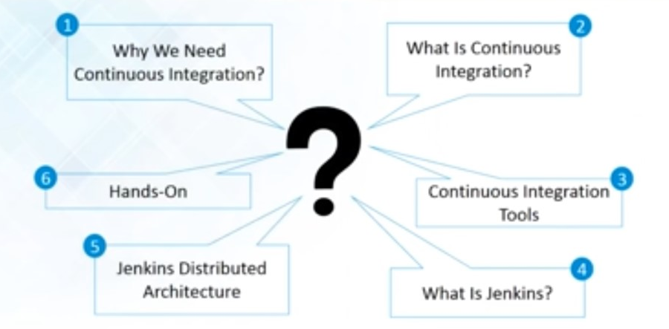
Continuous Integration Overview

Slide 3
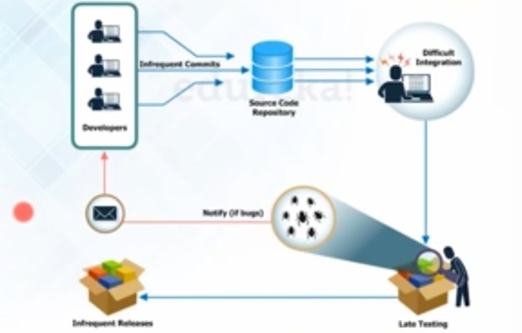
Before Continuous Integration

Slide 4
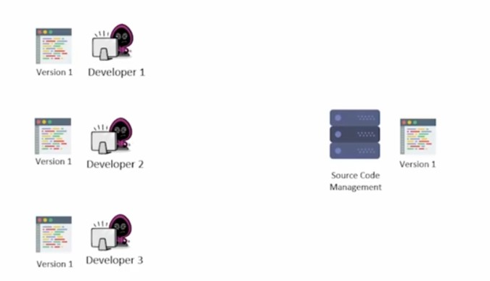
Need of Continuous Integration

Slide 5
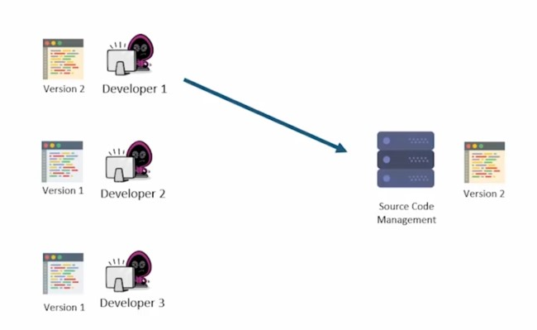
Need of Continuous Integration

Slide 6
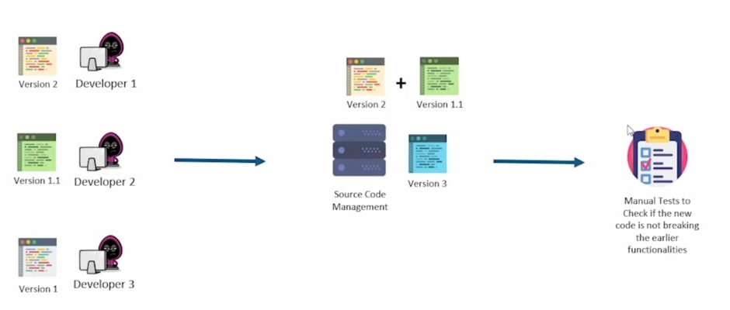
Need of Continuous Integration

Slide 7
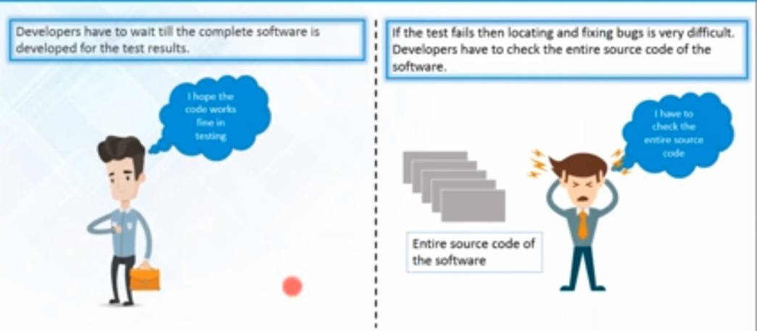
Need of Continuous Integration

Slide 8
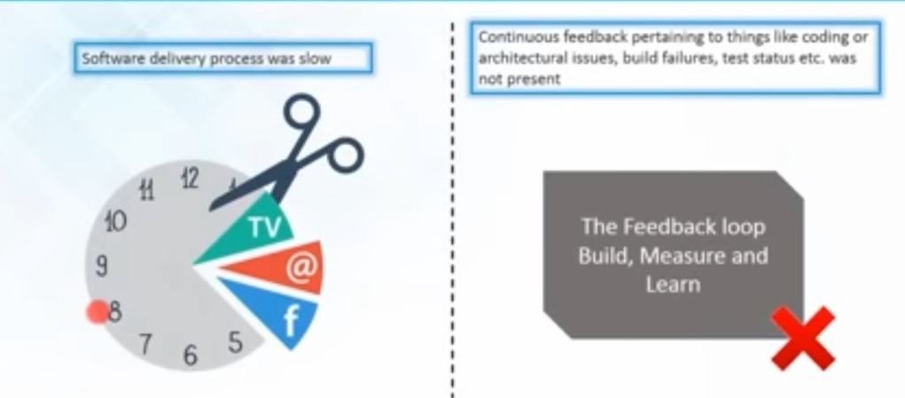
Need of Continuous Integration

Slide 9
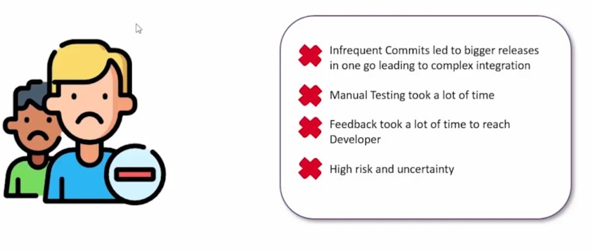
Need of Continuous Integration

Slide 10
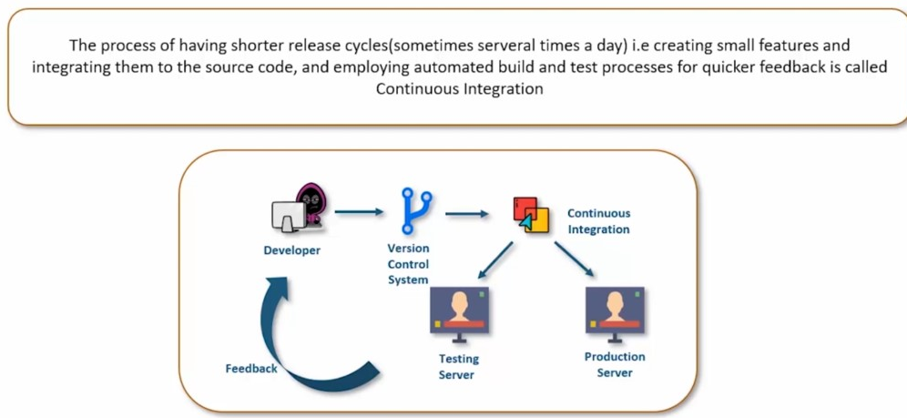
What is Continuous Integration

Slide 11
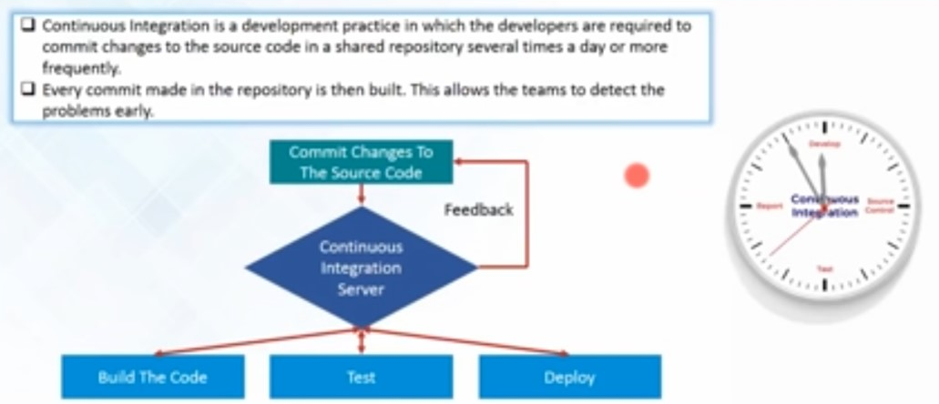
What is Continuous Integration

Slide 12
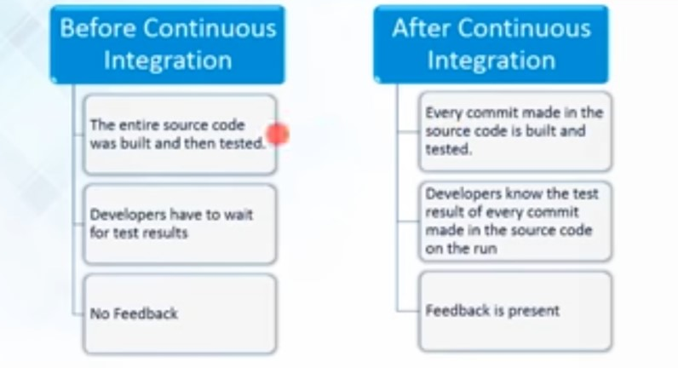
Before and After Continuous Integration Comparison

Slide 13
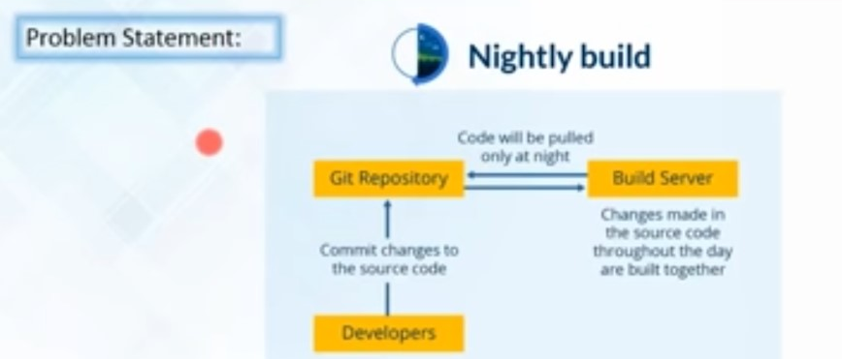
Case Study – Continuous Integration

Slide 14
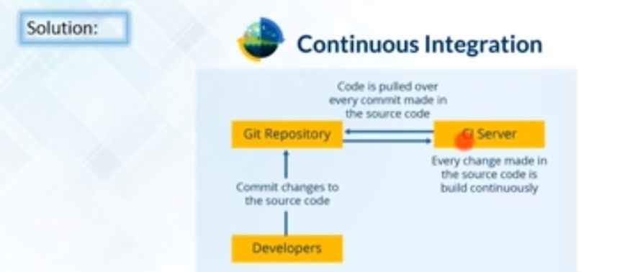
Case Study – Continuous Integration

Slide 15
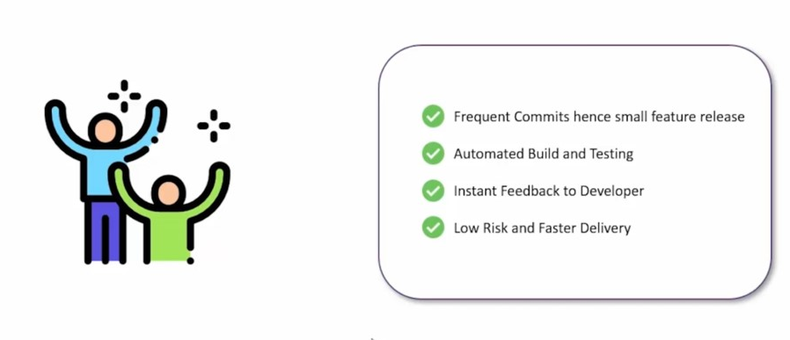
Continuous Integration Advantages

Slide 16

Continuous Integration Tools

Slide 17
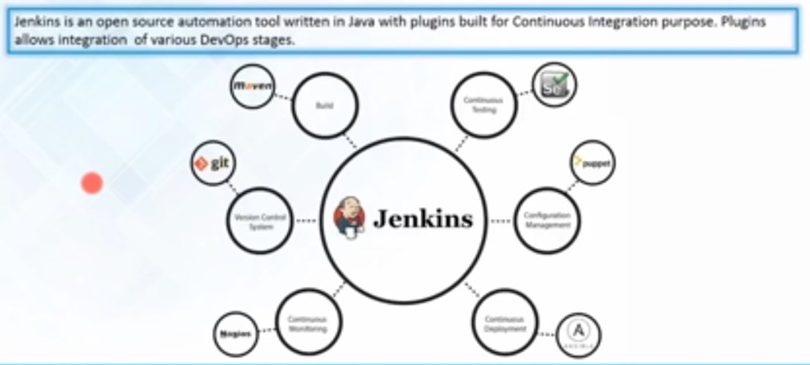
Jenkins

Slide 18
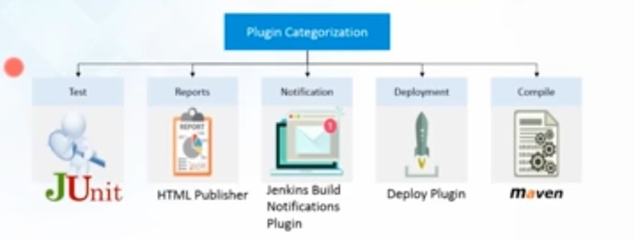
Jenkins Plugins

Slide 19
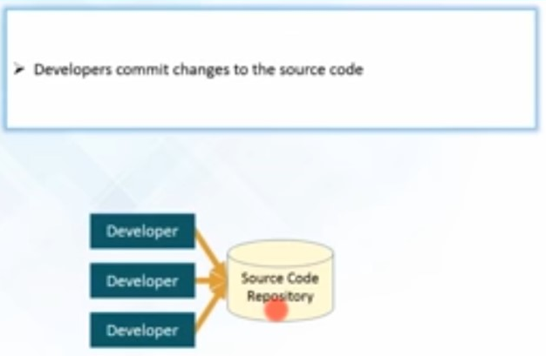
Continuous Integration Example

Slide 20
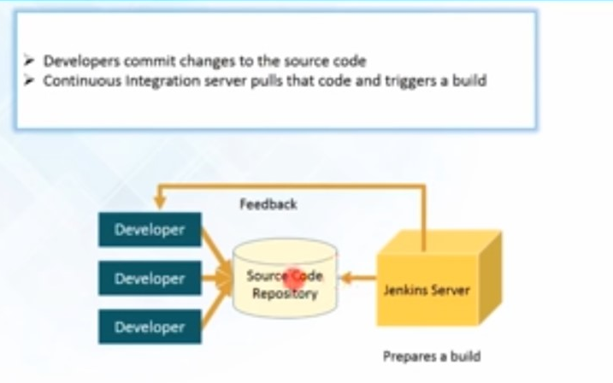
Continuous Integration Example

Slide 21
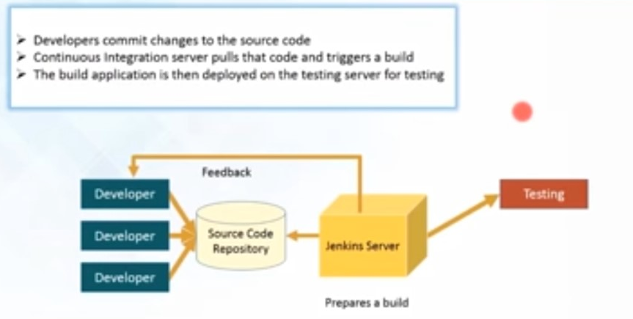
Continuous Integration Example

Slide 22
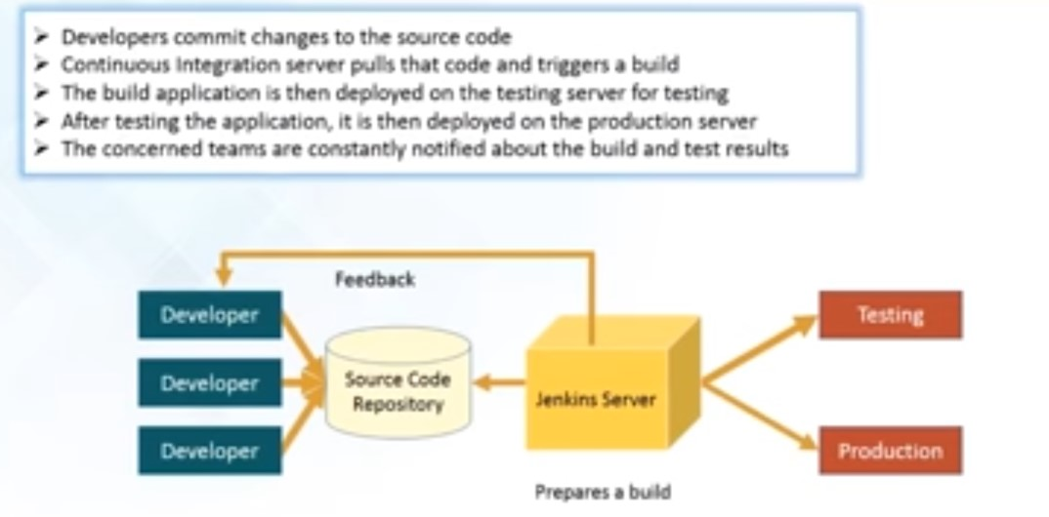
Continuous Integration Example

Slide 23
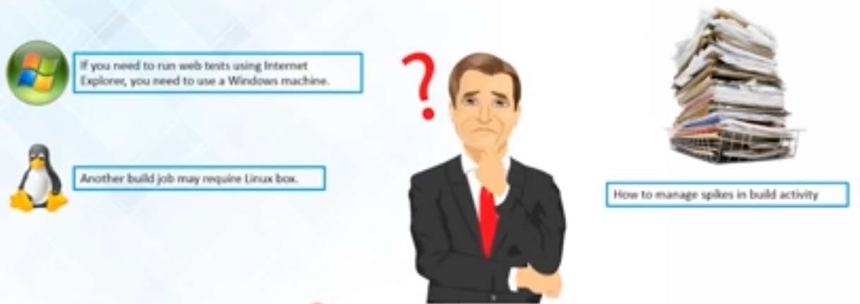
Jenkins – Master Slave Architecture ?

Slide 24
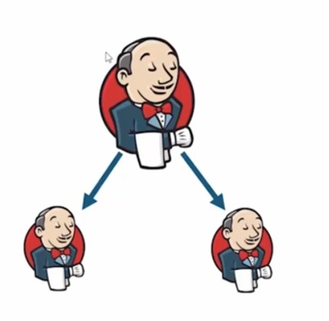
Jenkins – Master Slave Architecture

Slide 25
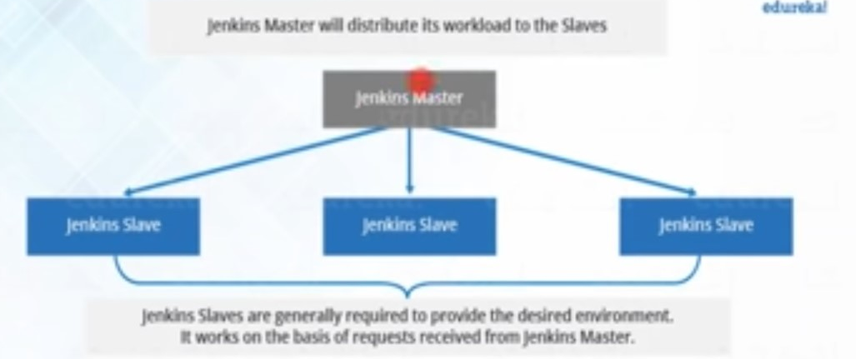
Jenkins – Master Slave Architecture

Slide 26
Scripted vs Declarative Pipeline
Declarative:
pipeline {
agent any
stages {
stage('Hello World') {
steps {
sh 'echo Hello World'
}
}
}
}
Scripted:
node {
stage('Hello world') {
sh 'echo Hello World'
}
}

Slide 27
Scripted vs Declarative Pipeline
Declarative:
pipeline {
agent any
stages {
stage('Build') {
steps {
// Clean, compile, test, and package Maven app
script {
sh 'mvn clean compile test package'
}
}
}
}
}
Scripted:
node {
stage('Build') {
// Clean, compile, test, and package Maven app
sh 'mvn clean compile test package'
}
}

Slide 28
Scripted vs Declarative Pipeline
node('38Server') {
stage('Clone Repository') {
// Checkout the code from GitHub
checkout([$class: 'GitSCM', branches: [[name: '*/main']], doGenerateSubmoduleConfigurations: false, extensions: [], submoduleCfg: [], userRemoteConfigs: [[url: 'https://github.com/your-username/your-repo.git']]])
}
stage('Compile') {
// Build the Maven project
sh 'mvn clean compile'
}
stage('Code Review') {
// Add your code review tools here (e.g., Checkstyle, PMD)
// Example: sh 'mvn checkstyle:checkstyle pmd:pmd'
}
stage('Test') {
// Run tests and generate JUnit reports
sh 'mvn test'
step([$class: 'JUnitResultArchiver', testResults: '**/target/surefire-reports/*.xml'])
}
stage('Package') {
// Package the application (e.g., create JAR file)
sh 'mvn package'
}
stage('Run JAR') {
// Run the JAR file
sh 'java -jar target/your-app.jar'
}
stage('Publish HTML Report') {
// Publish HTML reports (e.g., Checkstyle, PMD, etc.)
// Example: publishHTML(target: [allowMissing: false, alwaysLinkToLastBuild: true, keepAll: true, reportDir: 'target/site/checkstyle'], reportFiles: 'checkstyle-result.xml', reportName: 'Checkstyle Report')
}
// Add more stages as needed
stage('Cleanup') {
// Cleanup steps, if any
}
}

Slide 29
Scripted vs Declarative Pipeline
node('38Server') {
stage('Clone Repository') {
// Checkout the Node.js project from GitHub
checkout([$class: 'GitSCM', branches: [[name: '*/main']], doGenerateSubmoduleConfigurations: false, extensions: [], submoduleCfg: [], userRemoteConfigs: [[url: 'https://github.com/your-username/your-node-project.git']]])
}
stage('Install Node.js and npm') {
sh 'sudo apt-get install -y nodejs'
sh 'sudo apt-get install -y npm'
}
stage('Install Dependencies') {
// Install project dependencies using npm
sh 'npm install'
}
stage('Run Node.js Server') {
// Start the Node.js server
sh 'node server.js' // Replace 'server.js' with the actual entry point file for your Node.js application
}
}
}

